Slide 1
KENDO UI
AMAL DEV

Slide 2
AGENDA
Introduction
Overview
Flavors
Installation
Support
Web Widgets
Theming and Styling

Slide 3
Introduction
Developed by Telerik
End to End solution for modern client side development
Used by over 100K customers worldwide
Minimal external dependencies
Not based on jQuery UI
Notes:
everything you need for building applications for modern web standards, saving developers time and minimizing frustration by providing an integrated - yet highly modular - framework.
t provide many useful and robust building blocks for modern web applications
can use jQuery UI with Kendo UI without conflict
Kendo UI has been built from the ground-up to deliver a rich, HTML5-based application framework

Slide 4
What is Kendo UI
HTML5/CSS3/jQuery based framework
Lot of Web Widgets
Rich Data Visualization Framework
Auto-Adaptive Mobile Framework
Cross Browser Support
Cross Platform Support
Support for PHP, JSP, ASP.NET
Notes:
Basically a collection of styles, scripts and images
Leverages existing technologies to make rich immersive web applications
pure JavaScript framework with CSS defined for styling and behaviors

Slide 5
Components
Kendo UI Web
Kendo UI DataViz
Kendo UI Mobile
Notes:
Contains the core functionality of Kendo UI framework, including the DataSource component, templates, drag-and-drop, and themeable widgets with integrated animations.
A collection of HTML5-powered, mobile-ready, data visualization widgets
Native UI widgets for building HTML5-powered apps and sites for modern mobile devices.
Web – contains core functionality, widgets for both web and touch enabled desktop development
DataViz – used for development of desktop websites as well as mobile websites, normally used for representing data which include charts as well as guages
Mobile – features adaptive rendering technology which displays natively feel for ios, android, wp, includes controls such as scroll view, tab strip, list view, navigation buttons
Features – performance

Slide 6
Flavours
Kendo UI Core
Kendo UI Professional
Telerik UI for ASP.NET MVC
Telerik UI for JSP
Telerik UI for PHP
Notes:
Free, open source, includes web, mobiles widgets and framework features
Includes web data viz, mobile widgets and framework features
ASP.NET MVC wrapper for all available widgets
JSP wrappers available for web and data viz widgets
PHP available for web and data viz widgets
Server side wrappers are classes or xml tags which generates kendo ui widgets from server side code

Slide 7
jQuery UI vs Kendo UI
Category | jQuery UI | Kendo UI
Widgets (Total) | Yes (12) | Yes (28)
Themes (Total) | Yes (24) | Yes (11)
Effects (Total) | Yes (13) | Yes (8)
Interactions (Total) | Yes (5) | Yes (6)
Templates | No | Yes
DataSource | No (Dataview) | Yes
Model-View-ViewModel (MVVM) | No | Yes
Data Visualization | No | Yes
Globalization | Yes (Globalize) | Yes
Validation | No | Yes
Browser Support | IE 8+, Latest 2 versions of Chrome, Firefox, Safari, and Opera | IE 7+, Firefox ESR, Safari 5+ (OS X), Opera 11+, Chrome, Android 2.2+, iOS 4.0+
Mobile Device Compatibility | No (jQuery UI Touch Punch) | Yes
Notes:
http://jqueryuivskendoui.com/demos/widgets.html
For constructing front-end interface of your web applications
Themes can be customized by using themebuilder or by manually adding css, jquery has theme roller
Kendo ui has fewer effects, those present are only to support the visual tranisitions that occurs in its widgets
Interactions – jquery -> draggable, droppable, resizable. Kendo – Draggble, drop target, filtering resizing, are used as part of its widgets
Templates – jquery does not support, kendo has high perf oriented micro templating system based on implementation
Datasource component – powerful abstraction of data for using local or remote data. Fully supports crud,sorting, filtering, grouping
Dataviz – an api that provides charts, graphs ertc, uses svg or vml to render data viz

Slide 8
Widgets
AutoComplete
Button
Calendar
ColorPicker
ComboBox
DatePicker
DateTimePicker
DropDownList
Editor
Grid
ListView
MaskedTextBox
Menu
MultiSelect
Notification
NumericTextBox
PanelBar
Scheduler
Slider
Sortable
Splitter
TabStrip
TimePicker
Tooltip
TreeView
Upload
Window
Notes:
Kendo UI's widgets can be declaratively initialized using HTML5 data attributes.

Slide 9
Themes
Black
Blue Opal
Bootstrap
Default
Flat
High Contrast
Metro
Metro Black
Moonlight
Silver
Unicorn
Notes:
Widgets in both jQuery UI and Kendo UI support themes and styling via CSS
jQuery UI and Kendo UI support the ability to customize themes
can be done either manually or through a visual tool that's provided by both frameworks
the jQuery UI ThemeRoller and the Kendo UI ThemeBuilder.

Slide 10
Effects
Expand
Fade
Slide In
Flip
Transfer
Zoom
Page Turn
Tile
Replace
Notes:
Kendo UI has fewer integrated effects and easing functions than jQuery UI,
only present to support the visual transitions that occurs on its widgets

Slide 11
DataSource
Abstraction of Data in Kendo UI
Able to perform Local and Remote databinding
Fully supports CRUD operations
Supports local and server side sorting, paging, filtering, grouping and aggregates
Notes:
significant difference between jQuery UI and Kendo UI is support for a DataSource component
DataSource-like component called Dataview has been discussed for jQuery UI, but is currently on hold
is an abstraction for using local (arrays of JavaScript objects) or remote (XML, JSON, JSONP) data

Slide 12
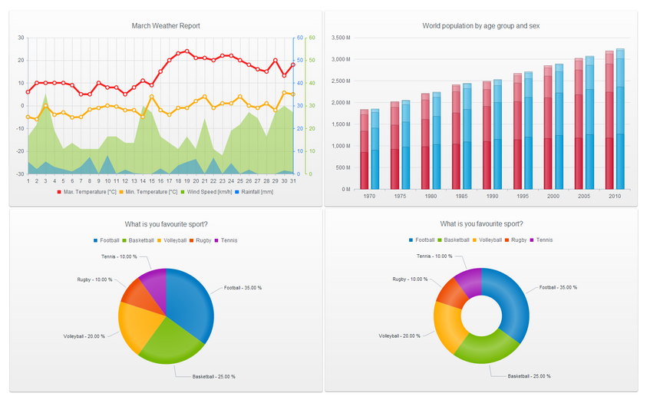
Data Visualization
Notes:
jQuery UI doesn’t provide Data Viz
Kendo UI Dataviz - an API that provides Pie, Line, Bar, Column, and Scatter charts.
Automatically uses SVG(scalable vector graphics) or VML(vector mark up language)
Depends on the capabilities of the browser

Slide 13
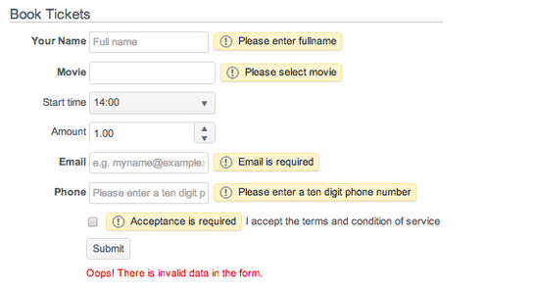
Validation
Validator component
Notes:
Validator component – offers mechanism for performing client side validation.
Built around HTML5 data attributes
supports variety of built-in validation rules
also provides a convenient way for setting custom rules handling

Slide 14
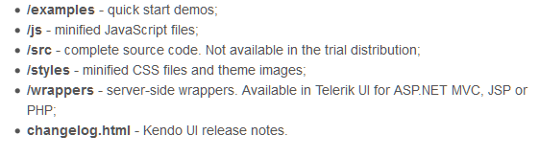
Installation
Requires jQuery v1.9.1
Download package from
http://www.telerik.com/download/kendo-ui
Package Structure

Slide 15
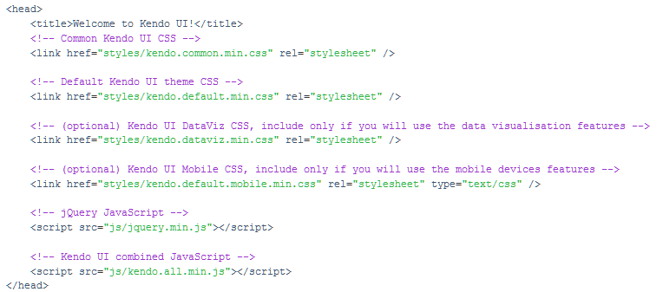
Usage
Copy JS and Styles directories to your root folder
Include the files in your page
Notes:
Common.css file is registered before the theme.css file

Slide 16


Initializing Widget
jQuery Syntax
HTML 5 Syntax
Notes:
Add an html element, select the element thru jquery and apply js method from kendo namespaces to convert it into a widget
Declarative Initialization- typically adds special attributes to your element starting with data-, then calls an initializer that reads these attributes and apply these changes

Slide 17
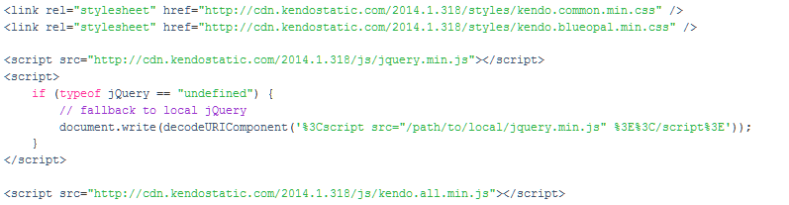
Kendo UI CDN
Hosted on Amazon Cloud Front
All are minified files
Local fallback option is recommended
Notes:
Should plan for a fallback option while using files hosted in cdn
Connectivity issues, firewalls, antivirus

Slide 18
Best Practices
Include only what you need.
Seperate js files are available for each widgets.
Avoid registering duplicate scripts.
Pick right combined script based on your project.
kendo.web.min.js -> core framework, desktop browser widgets
kendo.dataviz.min.js -> core framework, data viz widgets
kendo.mobile.min.js - > core framework, mobile specific widgets
Use Download builder for custom combined script
Notes:
3. kendo.grid.js should not be registered together with kendo.web.js or kendo.all.js
5. Only for licensed user, core users can opt for grunt

Slide 19
Demo
Getting Started
Using jQuery plugin
Using Markup

Slide 20
Demo
Initialize multiple Items at Once
Chaining
Obtaining Reference
Widget Configuration
Event Binding
Notes:
Multiple items
Chaining
Avoid duplicate initialization
Obtain a reference using jquery

Slide 21
Styles & Themes
Common Styles for Widgets & Styles
Predefined Themes Included out of the box
BootStrap Support

Slide 22
Demo
Applying Styles
Adding Default Theme
Changing Themes
Adding Bootstrap
Notes:
Multiple items
Chaining
Avoid duplicate initialization
Obtain a reference using jquery

Slide 23
Globalization
Supported Widgets
Calendar
DatePicker
TimePicker
DateTimePicker
NumericTextBox
MaskedTextBox (globalized mask literals)
Scheduler
Gantt
Notes:
Process of designing and developing apps that support different cultures
Also knows as Internationalization
Culture defines specific info for number formats, week and month names, date and time formats etc
Globalize.js takes precedence

Slide 24
Globalization - Demo
Notes:
Multiple items
Chaining
Avoid duplicate initialization
Obtain a reference using jquery

Slide 25
Questions

Slide 26
Thank You
Amal Dev
www.techrepository.in

